Slide 1

V - Value function
Benny Bornfeld

Slide 2
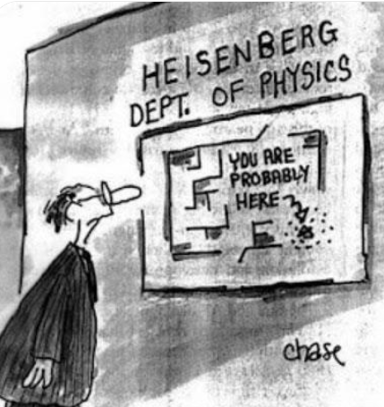
Welcome to the probabilistic world

Slide 3

Value function = G function + probability

Slide 4
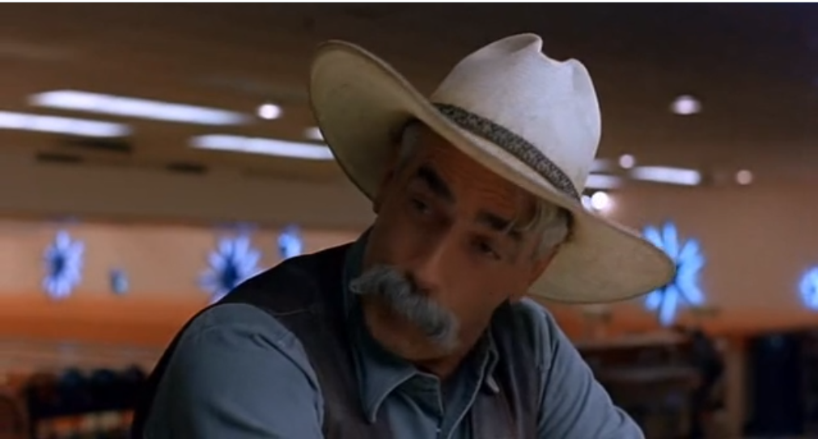
Sometime you eat the bear, sometime the bear eats you
https://vimeo.com/41103273

Slide 5
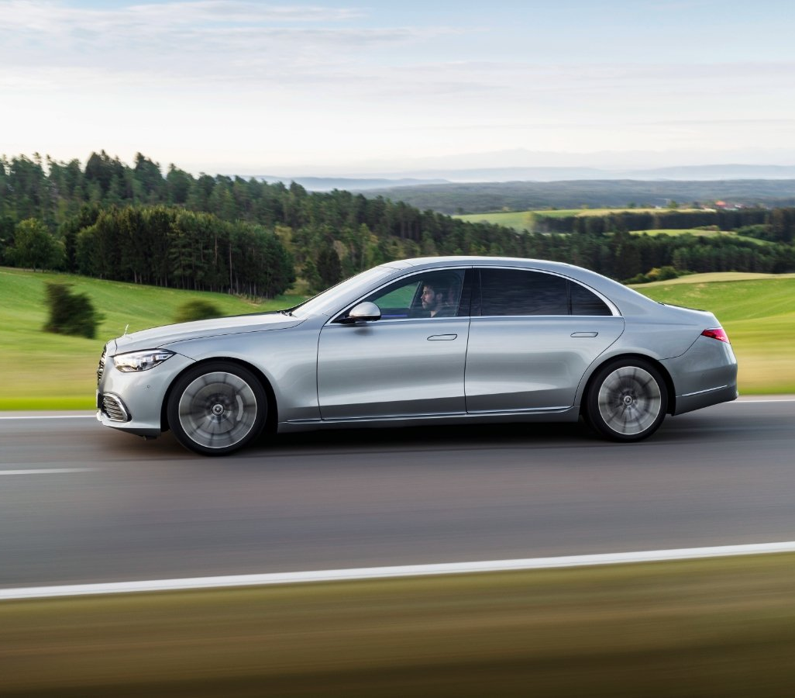

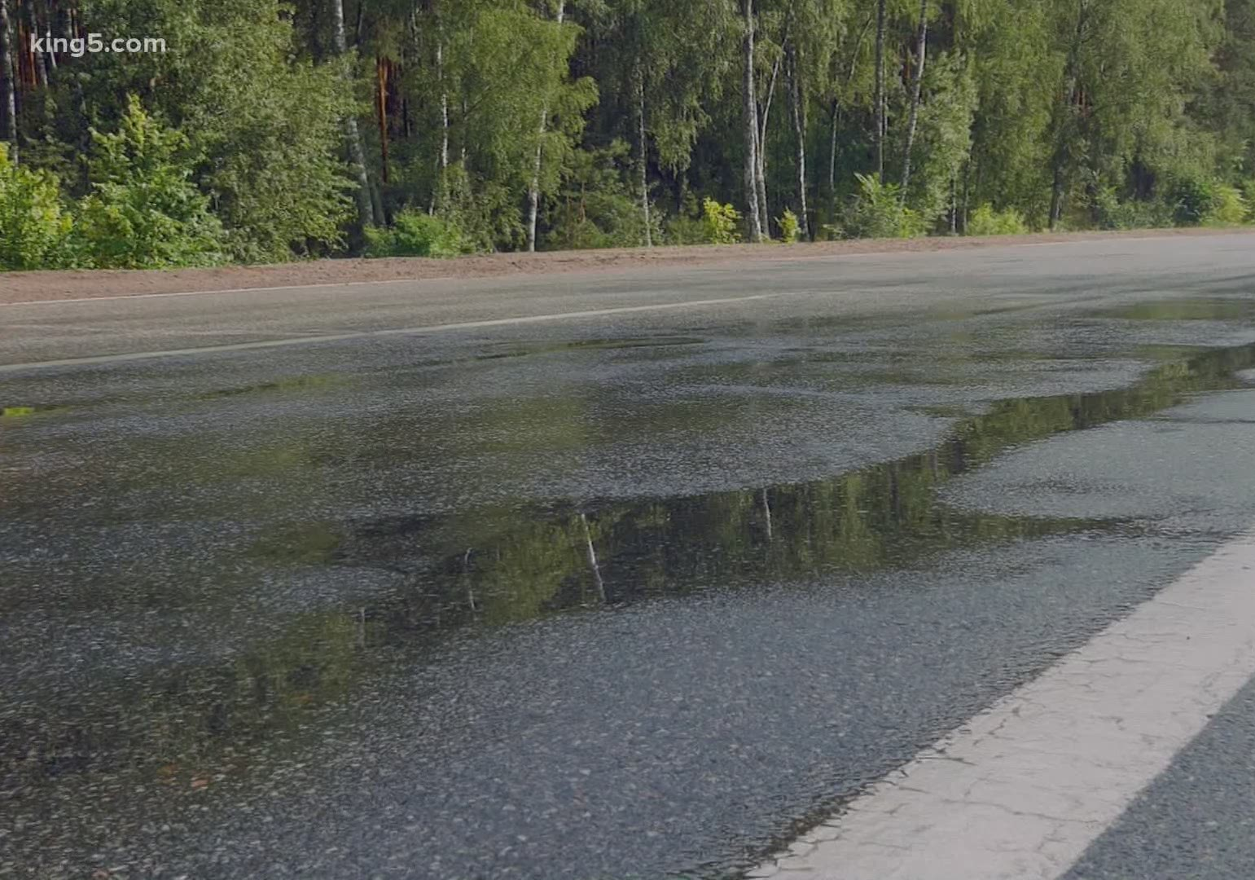
What is the next state (the position of the car in the near future)
?

Slide 6

Action -> State probability
Pass
R = 1
Study (p=?)
Fail
R = -1
Do not study (p=1)

Slide 7
Action -> State probability
The same action may lead to different states
Pass
R = 1
Study (p=0.95)
Study (p=0.05)
Do not study (p=1)
Fail
R = -1

Slide 8
Action -> State probability
$V_{π}=$ $P_{\left(pass | study\right) ∗ }$ $R_{(pass) } +P_{\left(fail | study\right) ∗ } R_{\left(fail\right) }$ = 0.95 * 1 + 0.05 * -1 = 0.9
We’re maximizing the expected return. It is the average return that we will get if we play many games.
Pass
R = 1
Study (p=0.95)
Study (p=0.05)
Fail
R = -1

Slide 9
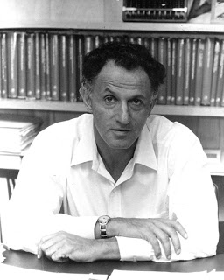
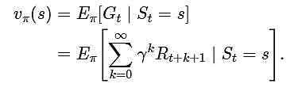
The Bellman Equation

Slide 10















Slippery/Windy GridWorld
Action – State with probabilities
$$γ=0.9$$
S2
S1
R = +1
right
1
$V=$ 1
$V=$ 0
S6
0.8
S5
R = -1
0.8
0.2
up
$V$ = ?
0.2
At this stage we assume that R is not stochastic
$$P_{\left(up | up\right) }$$
$$γ$$
$$V_{(s2) }$$
$$V_{(s5) }$$
$$R_{(s2) }$$
$$P_{\left(right | up\right) }$$
$$R_{(s5) }$$
$V=$ 0.8 * (0 + 0.9 * 1) + 0.2 * (-1 + 0) = 0.52

Slide 11
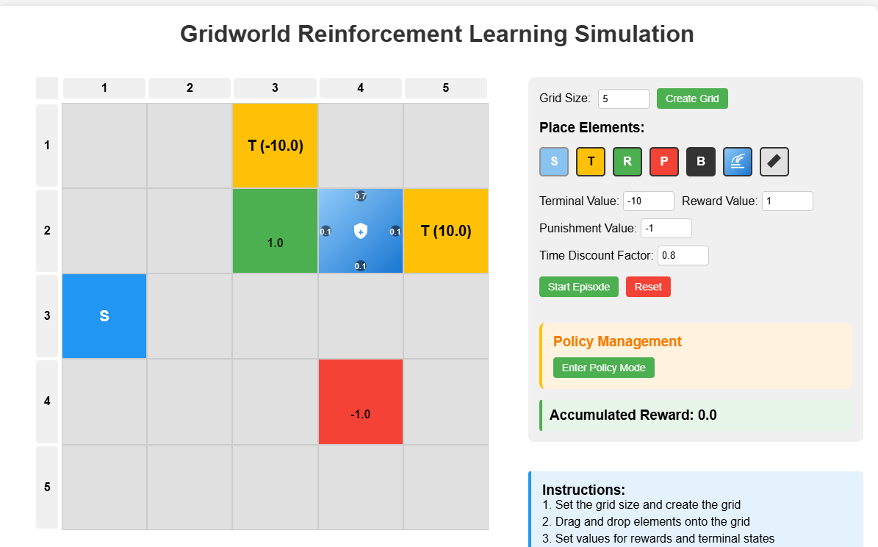
https://websim.ai/@snowyfield91121232/gridworld-rl-simulation/28

Slide 12
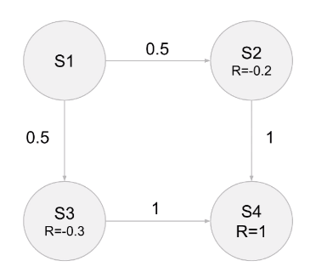
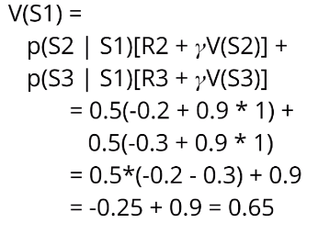

Bellman Example #1
$$γ=0.9$$
What is the value of V(s1)?

Slide 13
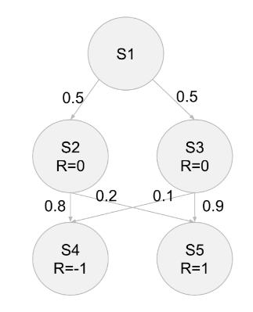
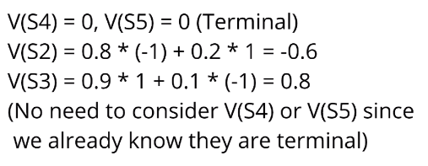
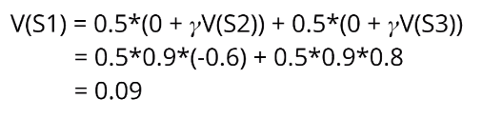

Bellman Example #2
$$γ=0.9$$

Slide 14
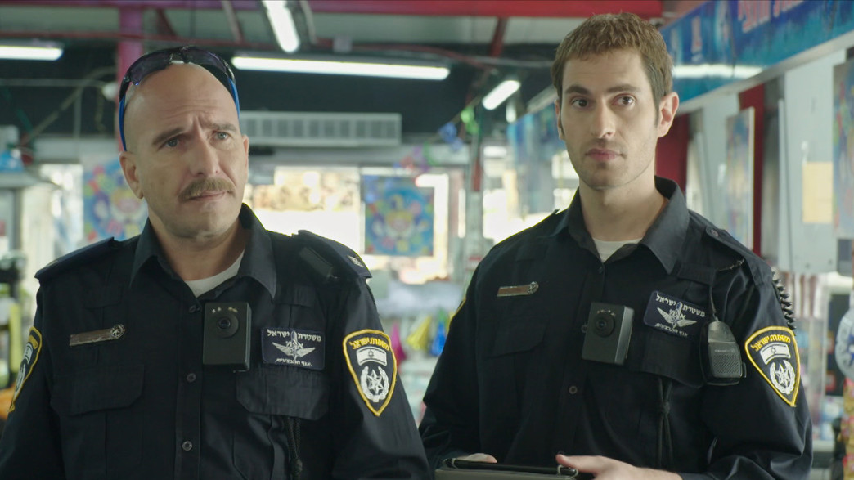
Probabilistic Action
https://www.tiktok.com/@colakelev/video/7044916370886249729?lang=he-IL

Slide 15


Probabilistic Action
Policy probability: to Avoid getting hit
50% - Jump
50% - Duck
State probability
Jump (Hit:0.4, Safe: 0.6)
Duck (Hit:0.8, Safe: 0.2)
Agent Strategy
Safe 0
D 0.2
Start
J 0.6
Probabilistic
Environment
J 0.4
D 0.8
Hit -1
Do nothing: 1

Slide 16
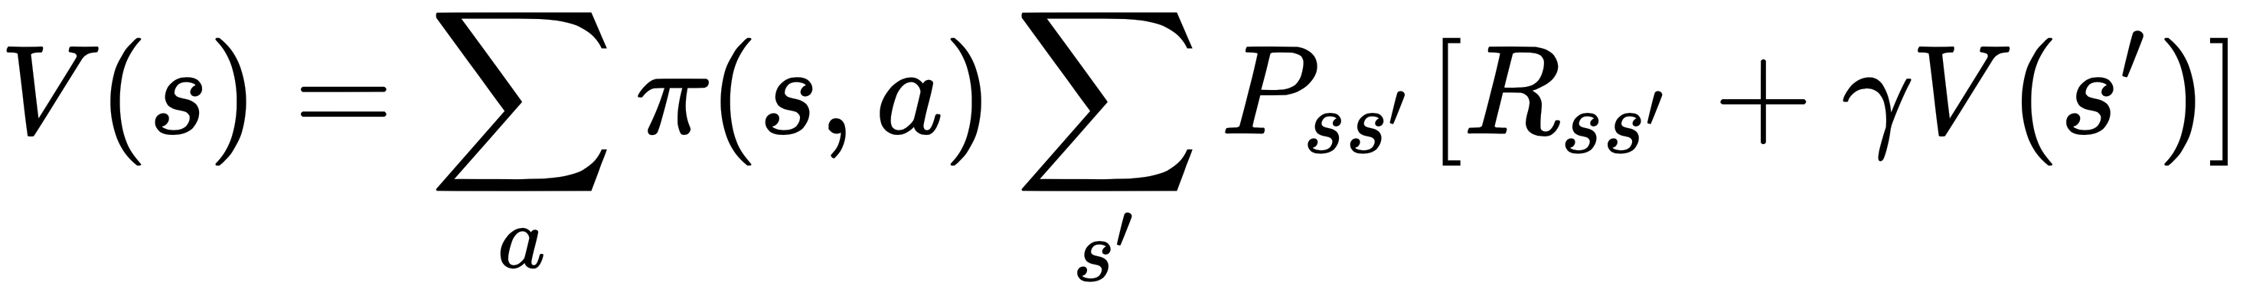
Probabilistic Action
Policy probability: to Avoid getting hit
50% - Jump
50% - Duck
State probability
Jump (Hit:0.4, Safe: 0.6)
Duck (Hit:0.8, Safe: 0.2)
V(Start) =
0.5 * ( 0.6 * (0 + 0) + (0.4 * (-1 + 0)) +
0.5 * ( 0.2 * (0 + 0) + (0.8 * (-1 + 0))
Agent Strategy
Safe 0
Probabilistic
Environment
D 0.2
Start
J 0.6
J 0.4
Jump
D 0.8
Hit -1
Duck
Do nothing: 1
Actions
State Transition

Slide 17

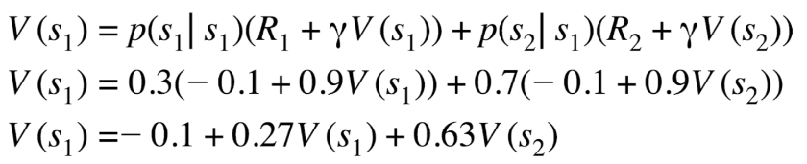
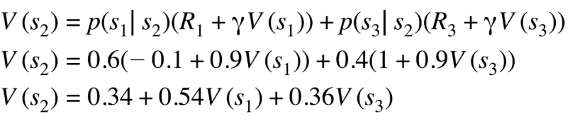
Circular MDP
Can move backwards… endless cycle
S3
R = +1
0.6
0.4
S1
R = -0.1
S2
R = -0.1
0.3
0.7

Slide 18
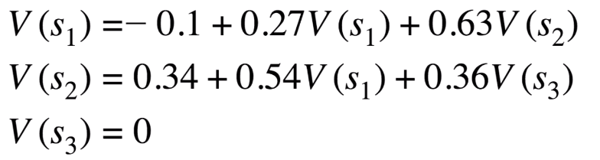
Solving linear equations
V can be calculated by solving n linear equations with n variables (V1,V2……, Vn)
In practice, In many cases it is not feasible to solve it in this manner since the number of states is very large

Slide 19

Take home message
The G function is the sum of future rewards
The V function is the sum of future rewards in a probabilistic environment.
The new state can be probabilistic, unpredictable environment (e.g. slippery road)
The policy can be probabilistic, agent tactics (e.g. 50% jump/50% duck)
The rewards can be probabilistic (e.g. uncertainty in the amount of gold we will find)
We can solve the V values using the “Working Backward Method” or “Linear Equations” in the case there are loops.

